Slide 1
DISTRIBUTED AND CLOUD COMPUTING
UNIT – 1 – INTRODUCTION
Notes:
NOTE:
To change the image on this slide, select the picture and delete it. Then click the Pictures icon in the placeholder to insert your own image.

Slide 2
INTRODUCTION
Definition - Distributed System
Relation to computer system components
Message-passing systems versus shared memory systems
Primitives for distributed communication
Synchronous versus asynchronous executions.
A model of distributed computations:
A distributed program
A model of distributed executions
Models of communication networks
Global state of a distributed system.

Slide 3
DEFINITION – DISTRIBUTED SYSTEM
Definition
A distributed system is a collection of independent entities that cooperate to solve a problem that cannot be individually solved.
Distributed systems have been in existence since the start of the universe.
Distributed systems characterized
You know you are using one when the crash of a computer you have never heard of prevents you from doing work.
A collection of independent computers that appears to the users of the system as a single coherent computer

Slide 4
DEFINITION – DISTRIBUTED SYSTEM
A distributed system can be characterized as a collection of mostly autonomous processors communicating over a communication network.
Distributed System Features:
No common physical clock This is an important assumption because it introduces the element of “distribution” in the system and gives rise to the inherent asynchrony amongst the processors.
No shared memory This is a key feature that requires message-passing for communication. This feature implies the absence of the common physical clock.
Geographical separation The geographically wider apart that the processors are, the more representative is the system of a distributed system.
Autonomy and heterogeneity The processors are “loosely coupled” in that they have different speeds and each can be running a different operating system.

Slide 5
RELATION TO COMPUTER SYSTEM COMPONENTS
Each computer has a memory-processing unit and the computers are connected by a communication network.
The relationships of the software components that run on each of the computers and use the local operating system and network protocol stack for functioning.
The distributed software is also termed as middleware.
A distributed execution is the execution of processes across the distributed system to collaboratively achieve a common goal. An execution is also sometimes termed a computation or a run.
The distributed system uses a layered architecture to break down the complexity of system design.
The middleware is the distributed software that drives the distributed system, while providing transparency of heterogeneity at the platform level

Slide 6
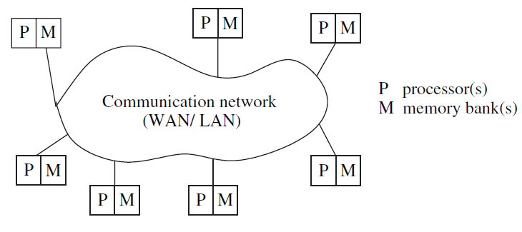
RELATION TO COMPUTER SYSTEM COMPONENTS
A distributed system connects processors by a communication network.

Slide 7
RELATION TO COMPUTER SYSTEM COMPONENTS
The interaction of this software with these system components at each processor.
Here we assume that the middleware layer does not contain the traditional application layer functions of the network protocol stack, such as http, mail, ftp, and telnet.
Various primitives and calls to functions defined in various libraries of the middleware layer are embedded in the user program code.
There exist several libraries to choose from to invoke primitives for the more common functions – such as reliable and ordered multicasting – of the middleware layer.

Slide 8
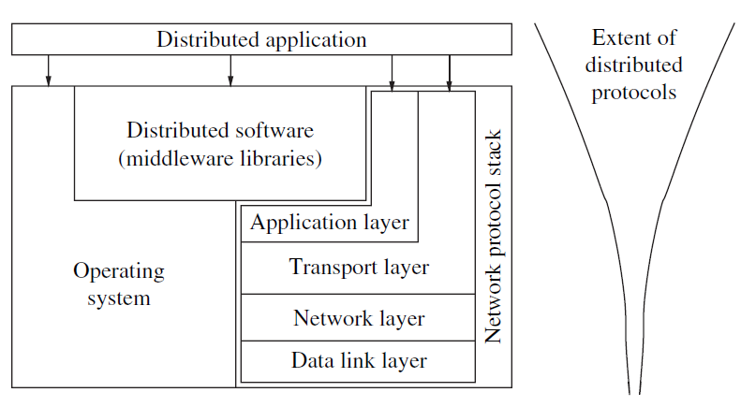
RELATION TO COMPUTER SYSTEM COMPONENTS
Interaction of the software components at each processor.

Slide 9
RELATION TO COMPUTER SYSTEM COMPONENTS
There are several standards such as Object Management Group’s (OMG) common object request broker architecture (CORBA), and the remote procedure call (RPC) mechanism.
The RPC mechanism conceptually works like a local procedure call, with the difference that the procedure code may reside on a remote machine, and the RPC software sends a message across the network to invoke the remote procedure.
It then awaits a reply, after which the procedure call completes from the perspective of the program that invoked it.
Currently deployed commercial versions of middleware often use CORBA, DCOM (distributed component object model), Java, and RMI (remote method invocation) technologies.
The message-passing interface (MPI) developed in the research community is an example of an interface for various communication functions.

Slide 10
MOTIVATION – DISTRIBUTED SYSTEM
Inherently distributed computations In many applications such as money transfer in banking, or reaching consensus among parties that are geographically distant, the computation is inherently distributed.
Resource sharing Resources such as peripherals, complete data sets in databases, special libraries, as well as data (variable/files) cannot be fully replicated at all the sites because it is often neither practical nor cost-effective.
Access to geographically remote data and resources In many scenarios, the data cannot be replicated at every site participating in the distributed execution because it may be too large or too sensitive to be replicated.
Enhanced reliability A distributed system has the inherent potential to provide increased reliability because of the possibility of replicating resources and executions, as well as the reality that geographically distributed resources are not likely to crash/malfunction at the same time under normal circumstances.

Slide 11
MOTIVATION – DISTRIBUTED SYSTEM
Increased performance/cost ratio By resource sharing and accessing geographically remote data and resources, the performance/cost ratio is increased.
Scalability As the processors are usually connected by a wide-area network, adding more processors does not pose a direct bottleneck for the communication network.
Modularity and incremental expandability Heterogeneous processors may be easily added into the system without affecting the performance, as long as those processors are running the same middleware algorithms. Similarly, existing processors may be easily replaced by other processors.

Slide 12
Relation to parallel multiprocessor/multicomputer systems
Characteristics of parallel systems
Flynn’s taxonomy
Coupling, parallelism, concurrency, and granularity
Characteristics of parallel systems
A multiprocessor system is a parallel system in which the multiple processors have direct access to shared memory which forms a common address space.
Uniform Memory Access (UMA)
A multiprocessor system usually corresponds to a uniform memory access (UMA) architecture in which the access latency, i.e., waiting time, to complete an access to any memory location from any processor is the same.
The processors are in very close physical proximity and are connected by an interconnection network.

Slide 13
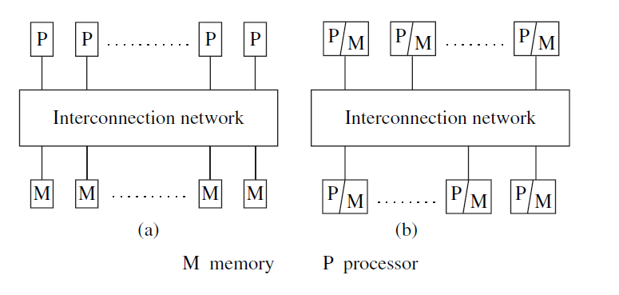
Relation to parallel multiprocessor/multicomputer systems
Characteristics of parallel systems
Uniform memory access (UMA) Non-uniform memory access (NUMA)
multiprocessor system multiprocessor

Slide 14
Relation to parallel multiprocessor/multicomputer systems
Characteristics of parallel systems
Non-Uniform Memory Access (NUMA)
A multicomputer parallel system is a parallel system in which the multiple processors do not have direct access to shared memory.
The memory of the multiple processors may or may not form a common address space.
Such computers usually do not have a common clock.
The processors communicate either via a common address space or via message-passing.
A multicomputer system that has a common address space usually corresponds to a non-uniform memory access (NUMA) architecture in which the latency to access various shared memory locations from the different processors varies.

Slide 15
Relation to parallel multiprocessor/multicomputer systems
Characteristics of parallel systems
Array processors
Array processors belong to a class of parallel computers that are physically co-located, are very tightly coupled, and have a common system clock (but may not share memory and communicate by passing data using messages).
Array processors and systolic arrays that perform tightly synchronized processing and data exchange in lock-step for applications such as DSP and image processing belong to this category.
These applications usually involve a large number of iterations on the data.

Slide 16
Relation to parallel multiprocessor/multicomputer systems
Flynn’s taxonomy
Flynn identified four processing modes, based on whether the processors execute the same or different instruction streams at the same time, and whether or not the processors processed the same (identical) data at the same time.
Single instruction stream, single data stream (SISD)
Single instruction stream, multiple data stream (SIMD)
Multiple instruction stream, single data stream (MISD)
Multiple instruction stream, multiple data stream (MIMD)

Slide 17
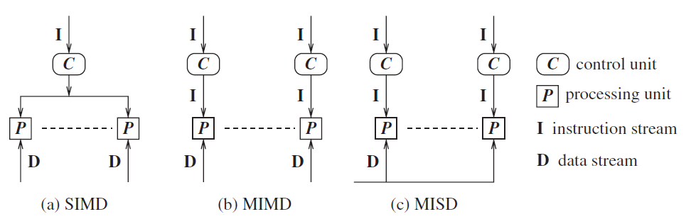
Relation to parallel multiprocessor/multicomputer systems
Flynn’s taxonomy

Slide 18
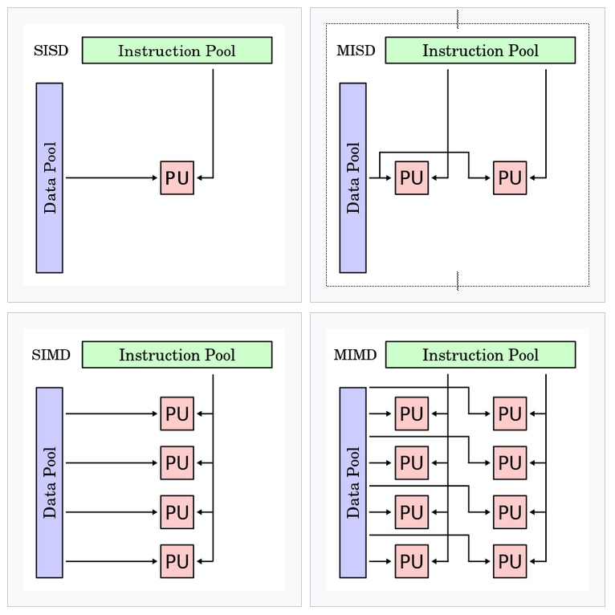
Relation to parallel multiprocessor/multicomputer systems
Flynn’s taxonomy

Slide 19
Relation to parallel multiprocessor/multicomputer systems
Flynn’s taxonomy
Single instruction stream, single data stream (SISD)
This mode corresponds to the conventional processing in the von Neumann paradigm with a single CPU, and a single memory unit connected by a system bus.

Slide 20
Relation to parallel multiprocessor/multicomputer systems
Flynn’s taxonomy
Single instruction stream, multiple data stream (SIMD)
This mode corresponds to the processing by multiple homogenous processors which execute in lock-step on different data items.
Applications that involve operations on large arrays and matrices, such as scientific applications, can best exploit systems that provide the SIMD mode of operation because the data sets can be partitioned easily.

Slide 21
Relation to parallel multiprocessor/multicomputer systems
Flynn’s taxonomy
Multiple instruction stream, single data stream (MISD)
This mode corresponds to the execution of different operations in parallel on the same data. This is a specialized mode of operation with limited but niche applications, e.g., visualization.

Slide 22
Relation to parallel multiprocessor/multicomputer systems
Flynn’s taxonomy
Multiple instruction stream, multiple data stream (MIMD)
In this mode, the various processors execute different code on different data.
This is the mode of operation in distributed systems as well as in the vast majority of parallel systems.
There is no common clock among the system processors.
Sun Ultra servers, multicomputer PCs, and IBM SP machines are examples of machines that execute in MIMD mode.

Slide 23
Relation to parallel multiprocessor/multicomputer systems
Coupling, parallelism, concurrency, and granularity
Coupling
The degree of coupling among a set of modules, whether hardware or software, is measured in terms of the interdependency and binding and/or homogeneity among the modules.
When the degree of coupling is high (low), the modules are said to be tightly (loosely) coupled.
SIMD and MISD architectures generally tend to be tightly coupled because of the common clocking of the shared instruction stream or the shared data stream.

Slide 24
Relation to parallel multiprocessor/multicomputer systems
Coupling, parallelism, concurrency, and granularity
Parallelism
This is a measure of the relative speedup of a specific program, on a given machine.
The speedup depends on the number of processors and the mapping of the code to the processors.
It is expressed as the ratio of the time T(1) with a single processor, to the time T(n) with n processors.

Slide 25
Relation to parallel multiprocessor/multicomputer systems
Coupling, parallelism, concurrency, and granularity
Concurrency
This is a broader term that means roughly the same as parallelism of a program, but is used in the context of distributed programs.
The parallelism/concurrency in a parallel/distributed program can be measured by the ratio of the number of local (non-communication and non-shared memory access) operations to the total number of operations, including the communication or shared memory access operations.

Slide 26
Relation to parallel multiprocessor/multicomputer systems
Coupling, parallelism, concurrency, and granularity
Granularity
The ratio of the amount of computation to the amount of communication within the parallel/distributed program is termed as granularity.
If the degree of parallelism is coarse-grained (fine-grained), there are relatively many more (fewer) productive CPU instruction executions, compared to the number of times the processors communicate either via shared memory or message passing and wait to get synchronized with the other processors.

Slide 27
Message-passing systems versus shared memory systems
Shared memory systems are those in which there is a (common) shared address space throughout the system.
Communication among processors takes place via shared data variables, and control variables for synchronization among the processors.
Semaphores and monitors that were originally designed for shared memory uniprocessors and multiprocessors are examples of how synchronization can be achieved in shared memory systems.
Emulating message-passing on a shared memory system (MP →SM)
Emulating shared memory on a message-passing system (SM →MP)

Slide 28
Message-passing systems versus shared memory systems
Emulating message-passing on a shared memory system (MP →SM)
The shared address space can be partitioned into disjoint parts, one part being assigned to each processor.
“Send” and “receive” operations can be implemented by writing to and reading from the destination/sender processor’s address space, respectively.
Specifically, a separate location can be reserved as the mailbox for each ordered pair of processes.
A P_{i}–P_{j} message-passing can be emulated by a write by P_{i} to the mailbox and then a read by P_{j} from the mailbox.
In the simplest case, these mailboxes can be assumed to have unbounded size.
The write and read operations need to be controlled using synchronization primitives to inform the receiver/sender after the data has been sent/received.

Slide 29
Message-passing systems versus shared memory systems
Emulating shared memory on a message-passing system (SM →MP)
This involves the use of “send” and “receive” operations for “write” and “read” operations.
Each shared location can be modelled as a separate process; “write” to a shared location is emulated by sending an update message to the corresponding owner process; a “read” to a shared location is emulated by sending a query message to the owner process.
As accessing another processor’s memory requires send and receive operations, this emulation is expensive.
Although emulating shared memory might seem to be more attractive from a programmer’s perspective, it must be remembered that in a distributed system, it is only an abstraction.
Thus, the latencies involved in read and write operations may be high even when using shared memory emulation because the read and write operations are implemented by using network-wide communication under the covers.

Slide 30
Primitives for distributed communication
Blocking/non-blocking, synchronous/asynchronous primitives
Processor synchrony
Libraries and standards
Blocking/non-blocking, synchronous/asynchronous primitives
Message send and message receive communication primitives are denoted Send() and Receive(), respectively.
A Send primitive has at least two parameters – the destination, and the buffer in the user space, containing the data to be sent.
Similarly, a Receive primitive has at least two parameters – the source from which the data is to be received (this could be a wildcard), and the user buffer into which the data is to be received.

Slide 31
Primitives for distributed communication
Blocking/non-blocking, synchronous/asynchronous primitives
There are two ways of sending data when the Send primitive is invoked – the buffered option and the unbuffered option.
The buffered option which is the standard option copies the data from the user buffer to the kernel buffer.
The data later gets copied from the kernel buffer onto the network.
In the unbuffered option, the data gets copied directly from the user buffer onto the network.
For the Receive primitive, the buffered option is usually required because the data may already have arrived when the primitive is invoked, and needs a storage place in the kernel.

Slide 32
Primitives for distributed communication
Synchronous primitives
A Send or a Receive primitive is synchronous if both the Send() and Receive() handshake with each other.
The processing for the Send primitive completes only after the invoking processor learns that the other corresponding Receive primitive has also been invoked and that the receive operation has been completed.
The processing for the Receive primitive completes when the data to be received is copied into the receiver’s user buffer.
Asynchronous primitives
A Send primitive is said to be asynchronous if control returns back to the invoking process after the data item to be sent has been copied out of the user-specified buffer.
It does not make sense to define asynchronous Receive primitives.

Slide 33
Primitives for distributed communication
Blocking primitives
A primitive is blocking if control returns to the invoking process after the processing for the primitive (whether in synchronous or asynchronous mode) completes.
Non-blocking primitives
A primitive is non-blocking if control returns back to the invoking process immediately after invocation, even though the operation has not completed.
For a non-blocking Send, control returns to the process even before the data is copied out of the user buffer.
For a non-blocking Receive, control returns to the process even before the data may have arrived from the sender.

Slide 34
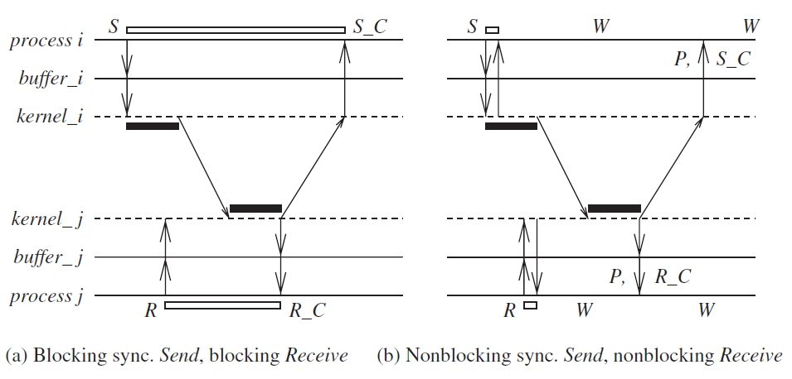
Primitives for distributed communication
Process P_{i} is sending and process P_{j} is receiving.

Slide 35
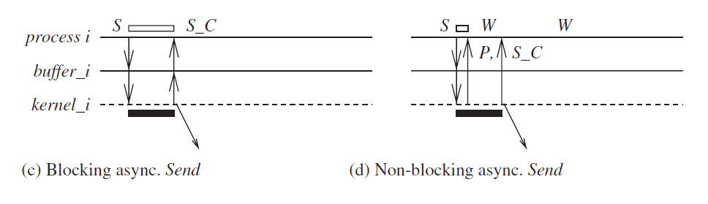
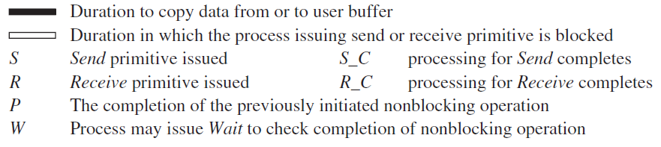
Primitives for distributed communication
Process P_{i} is sending and process P_{j} is receiving.

Slide 36
Primitives for distributed communication
(1) for the process execution
(2) for the user buffer from/to which data is sent/received
(3) for the kernel/communication subsystem.
Blocking synchronous Send
The data gets copied from the user buffer to the kernel buffer and is then sent over the network.
After the data is copied to the receiver’s system buffer and a Receive call has been issued, an acknowledgement back to the sender causes control to return to the process that invoked the Send operation and completes the Send.

Slide 37
Primitives for distributed communication
(1) for the process execution
(2) for the user buffer from/to which data is sent/received
(3) for the kernel/communication subsystem.
Non-blocking Synchronous
Control returns back to the invoking process as soon as the copy of data from the user buffer to the kernel buffer is initiated.
A parameter in the non-blocking call also gets set with the handle of a location that the user process can later check for the completion of the synchronous send operation.
The location gets posted after an acknowledgement returns from the receiver, as per the semantics described for (a).
The user process can keep checking for the completion of the non-blocking synchronous Send by testing the returned handle, or it can invoke the blocking Wait operation on the returned handle.

Slide 38
Primitives for distributed communication
(1) for the process execution
(2) for the user buffer from/to which data is sent/received
(3) for the kernel/communication subsystem.
Blocking Synchronous
The user process that invokes the Send is blocked until the data is copied from the user’s buffer to the kernel buffer.
(For the unbuffered option, the user process that invokes the Send is blocked until the data is copied from the user’s buffer to the network.)

Slide 39
Primitives for distributed communication
Non-Blocking Asynchronous
The user process that invokes the Send is blocked until the transfer of the data from the user’s buffer to the kernel buffer is initiated.
(For the unbuffered option, the user process that invokes the Send is blocked until the transfer of the data from the user’s buffer to the network is initiated.)
Control returns to the user process as soon as this transfer is initiated, and a parameter in the non-blocking call also gets set with the handle of a location that the user process can check later using the Wait operation for the completion of the asynchronous Send operation.
The asynchronous Send completes when the data has been copied out of the user’s buffer.
The checking for the completion may be necessary if the user wants to reuse the buffer from which the data was sent.

Slide 40
Primitives for distributed communication
Blocking Receive
The Receive call blocks until the data expected arrives and is written in the specified user buffer.
Then control is returned to the user process.
Non-Blocking Receive
The Receive call will cause the kernel to register the call and return the handle of a location that the user process can later check for the completion of the non-blocking Receive operation.
This location gets posted by the kernel after the expected data arrives and is copied to the user-specified buffer.
The user process can check for the completion of the non-blocking Receive by invoking the Wait operation on the returned handle. (If the data has already arrived when the call is made, it would be pending in some kernel buffer, and still needs to be copied to the user buffer.)

Slide 41
Primitives for distributed communication
Processor synchrony
Processor synchrony indicates that all the processors execute in lock-step with their clocks synchronized.
As this synchrony is not attainable in a distributed system, what is more generally indicated is that for a large granularity of code, usually termed as a step, the processors are synchronized.
This abstraction is implemented using some form of barrier synchronization to ensure that no processor begins executing the next step of code until all the processors have completed executing the previous steps of code assigned to each of the processors.

Slide 42
Primitives for distributed communication
Libraries and standards
There exists a wide range of primitives for message-passing.
Many commercial software products (banking, payroll, etc., applications) use proprietary primitive libraries supplied with the software marketed by the vendors (e.g., the IBM CICS software which has a very widely installed customer base worldwide uses its own primitives).
The message-passing interface (MPI) library and the PVM (parallel virtual machine) library are used largely by the scientific community, but other alternative libraries exist.
Commercial software is often written using the remote procedure calls (RPC) mechanism in which procedures that potentially reside across the network are invoked transparently to the user, in the same manner that a local procedure is invoked.

Slide 43
Synchronous versus asynchronous executions
An asynchronous execution is an execution in which
(i) there is no processor synchrony and there is no bound on the drift rate of processor clocks
(ii) message delays (transmission + propagation times) are finite but unbounded
(iii) there is no upper bound on the time taken by a process to execute a step.
An example asynchronous execution with four processes P₀ to P₃.
The arrows denote the messages; the tail and head of an arrow mark the send and receive event for that message, denoted by a circle and vertical line, respectively.
Non-communication events, also termed as internal events, are shown by shaded circles.

Slide 44
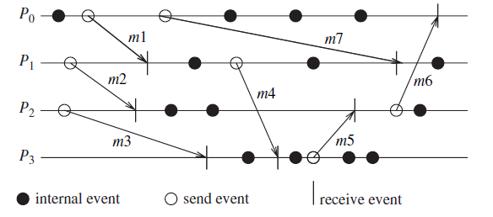
Synchronous versus asynchronous executions
An example of an asynchronous execution in a message-passing system. A timing diagram is used to illustrate the execution.

Slide 45
Synchronous versus asynchronous executions
A synchronous execution is an execution in which
(i) processors are synchronized and the clock drift rate between any two processors is bounded
(ii) message delivery (transmission + delivery) times are such that they occur in one logical step or round
(iii) there is a known upper bound on the time taken by a process to execute a step.
An example of a synchronous execution with four processes P₀ to P₃.
The arrows denote the messages.

Slide 46
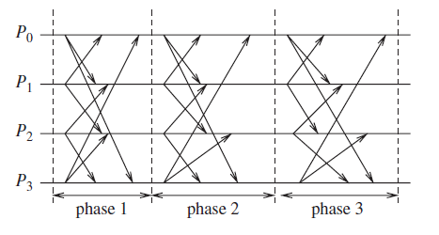
Synchronous versus asynchronous executions
An example of a synchronous execution in a message-passing system. All the messages sent in a round are received within that same round.

Slide 47
Synchronous versus asynchronous executions
The timing diagram of an example synchronous execution.
In this system, there are four nodes P₀ to P₃.
In each round, process P_{i} sends a message to P_{(i+1)}mod 4 and P_{(i−1)}mod 4 and calculates some application-specific function on the received values.
Emulating an asynchronous system by a synchronous system (A→S)
Emulating a synchronous system by an asynchronous system (S →A)
Emulations

Slide 48
Synchronous versus asynchronous executions
Emulating an asynchronous system by a synchronous system (A→S)
An asynchronous program (written for an asynchronous system) can be emulated on a synchronous system fairly trivially as the synchronous system is a special case of an asynchronous system – all communication finishes within the same round in which it is initiated.
Emulating a synchronous system by an asynchronous system (S →A)
A synchronous program (written for a synchronous system) can be emulated on an asynchronous system using a tool called synchronizer.

Slide 49
Synchronous versus asynchronous executions
Emulations
Four broad classes of programs the emulations in any class can be emulated by any other.
If system A can be emulated by system B, denoted A/B, and if a problem is not solvable in B, then it is also not solvable in A.
Likewise, if a problem is solvable in A, it is also solvable in B.
Hence, in a sense, all four classes are equivalent in terms of “computability” – what can and cannot be computed – in failure-free systems.

Slide 50
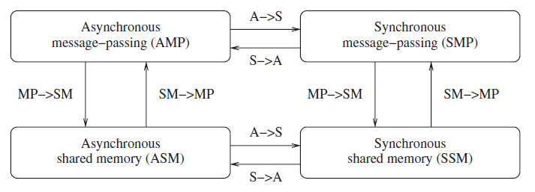
Synchronous versus asynchronous executions
Emulations
Emulations among the principal system classes in a failure-free system

Slide 51
A model of distributed computations:
A model of distributed computations:
A distributed system consists of a set of processors that are connected by a communication network.
The communication network provides the facility of information exchange among processors.
The communication delay is finite but unpredictable.
The processors do not share a common global memory and communicate solely by passing messages over the communication network.
There is no physical global clock in the system to which processes have instantaneous access.
The communication medium may deliver messages out of order, messages may be lost, garbled, or duplicated due to timeout and retransmission, processors may fail, and communication links may go down.

Slide 52
A model of distributed computations:
The system can be modeled as a directed graph in which vertices represent the processes and edges represent unidirectional communication channels.
A distributed application runs as a collection of processes on a distributed system.
A model of distributed computations:
A distributed program
A model of distributed executions
Models of communication networks
Global state of a distributed system

Slide 53
A model of distributed computations:
(1) A distributed program
A distributed program is composed of a set of n asynchronous processes p₁, p₂,…,pi,…,p_{n} that communicate by message passing over the communication network.
Without loss of generality, we assume that each process is running on a different processor.
The processes do not share a global memory and communicate solely by passing messages.
Let C_{ij} denote the channel from process pi to process p_{j} and let m_{ij} denote a message sent by p_{i} to p_{j}.

Slide 54
A model of distributed computations:
A distributed program
The communication delay is finite and unpredictable.
Also, these processes do not share a global clock that is instantaneously accessible to these processes.
Process execution and message transfer are asynchronous – a process may execute an action spontaneously and a process sending a message does not wait for the delivery of the message to be complete.
The global state of a distributed computation is composed of the states of the processes and the communication channels.
The state of a process is characterized by the state of its local memory and depends upon the context.
The state of a channel is characterized by the set of messages in transit in the channel.

Slide 55
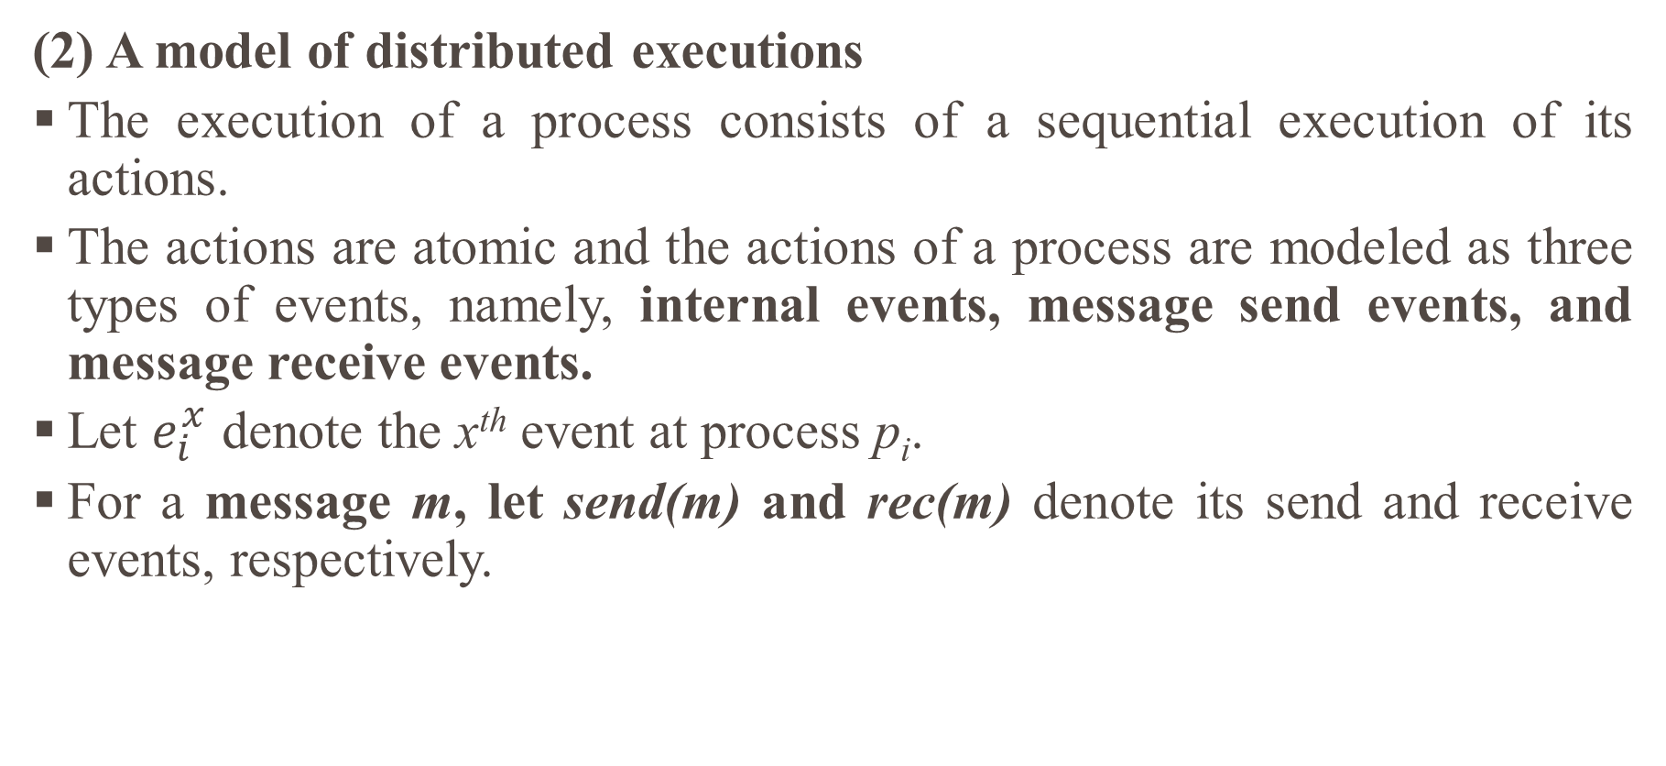
A model of distributed computations:
(2) A model of distributed executions
The execution of a process consists of a sequential execution of its actions.
The actions are atomic and the actions of a process are modeled as three types of events, namely, internal events, message send events, and message receive events.
Let $e_{i}^{x}$ denote the x^{th} event at process p_{i}.
For a message m, let send(m) and rec(m) denote its send and receive events, respectively.

Slide 56
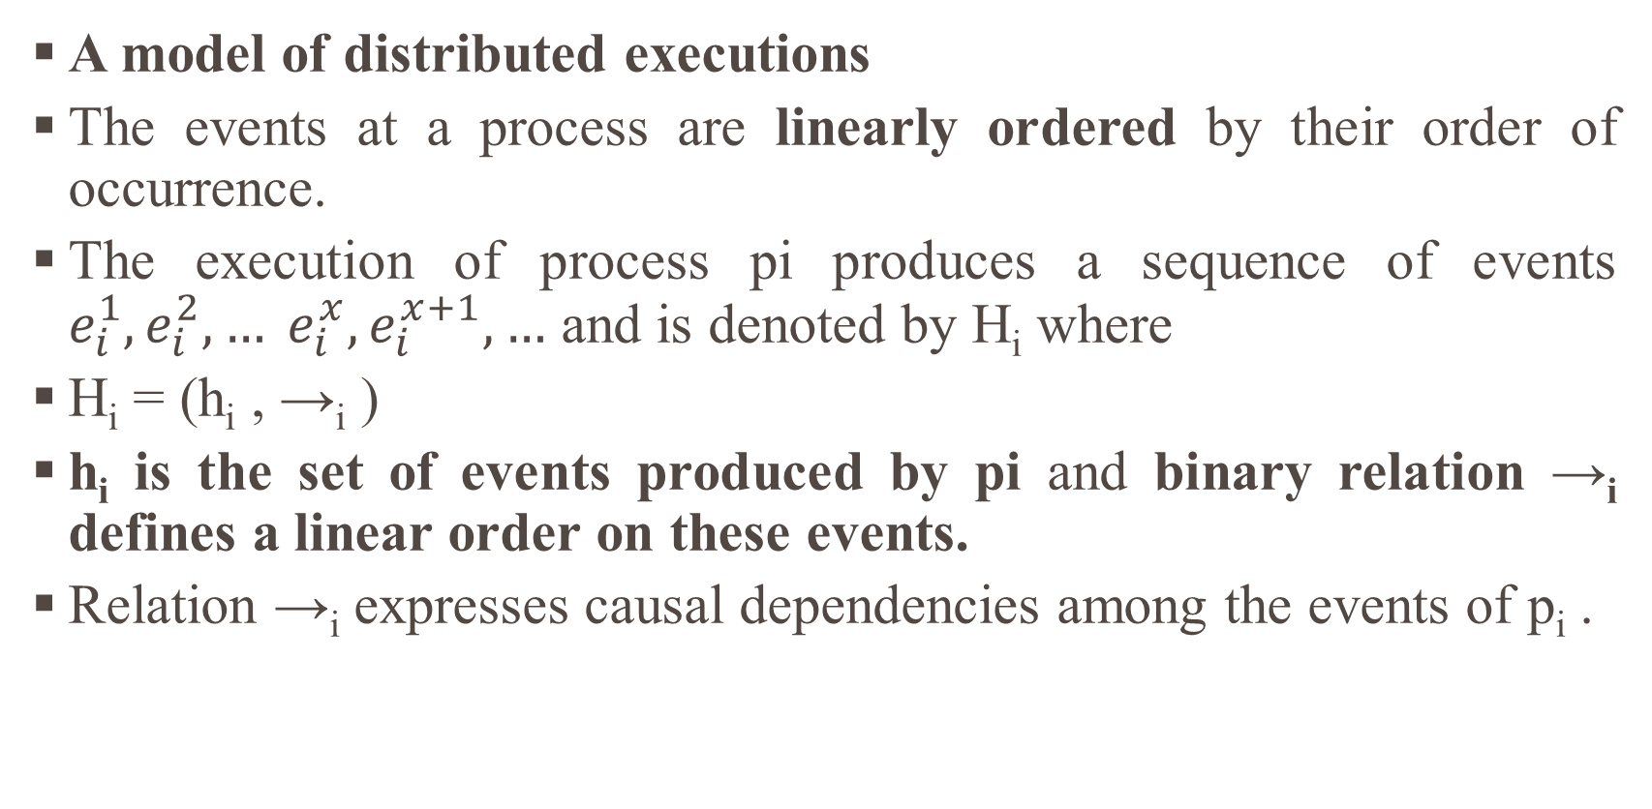
A model of distributed computations:
A model of distributed executions
The events at a process are linearly ordered by their order of occurrence.
The execution of process pi produces a sequence of events $e_{i}^{1},e_{i}^{2}, … e_{i}^{x}, e_{i}^{x+1}, …$ and is denoted by H_{i} where
H_{i} = (h_{i} , →_{i} )
h_{i} is the set of events produced by pi and binary relation →_{i} defines a linear order on these events.
Relation →_{i} expresses causal dependencies among the events of p_{i} .

Slide 57
A model of distributed computations:
A model of distributed executions
The send and the receive events signify the flow of information between processes and establish causal dependency from the sender process to the receiver process.
A relation →_{msg} that captures the causal dependency due to message exchange, is defined as follows. For every message m that is exchanged between two processes, we have
send(m) →_{msg} rec(m).
Relation →_{msg} defines causal dependencies between the pairs of corresponding send and receive events.

Slide 58
A model of distributed computations:
A model of distributed executions
The evolution of a distributed execution is depicted by a space-time diagram.
A horizontal line represents the progress of the process; a dot indicates an event; a slant arrow indicates a message transfer.
Since we assume that an event execution is atomic (hence, indivisible and instantaneous), it is justified to denote it as a dot on a process line.
In the Figure 2.1, for process p1, the second event is a message send event, the third event is an internal event, and the fourth event is a message receive event.

Slide 59
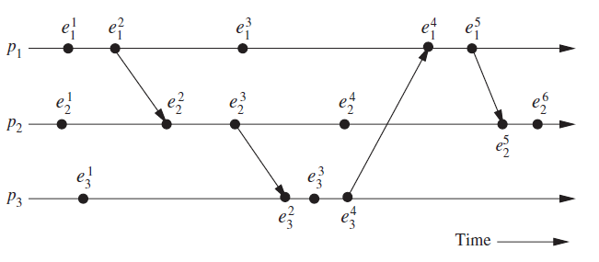
A model of distributed computations:
The space–time diagram of a distributed execution.

Slide 60
Properties Derived from Happen Before Relationship –
Transitive Relation –
If, TS(A) <TS(B) and TS(B) <TS(C), then TS(A) < TS(C)
Causally Ordered Relation –
a->b, this means that a is occurring before b and if there is any changes in a it will surely reflect on b.
Concurrent Event –
This means that not every process occurs one by one, some processes are made to happen simultaneously i.e., A || B.

Slide 61
Casual Precedence Relations:
It is the delivery of messages to a process in the order in which they were transmitted to that process.
It places a restriction on communication between processes by requiring that if the transmission of message mi to process pk necessarily preceded the transmission of message mj to the same process, then the delivery of these messages to that process must be ordered such that mi is delivered before mj.

Slide 62
Happen Before Relation:
The partial ordering obtained by generalizing the relationship between two process is called as happened-before relation or causal ordering or potential causal ordering. This term was coined by Lamport.
Happens-before defines a partial order of events in a distributed system. Some events can’t be placed in the order. If say A →B if A happens before B.

Slide 63
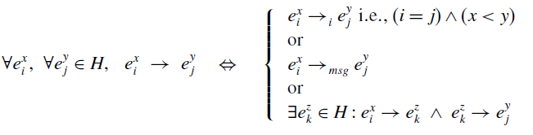
A model of distributed computations:
Causal Precedence Relation
The execution of a distributed application results in a set of distributed events produced by the processes.
Let H=∪_{i}h_{i} denote the set of events executed in a distributed computation.
Define a binary relation → on the set H as follows that expresses causal dependencies between events in the distributed execution.
The causal precedence relation induces an irreflexive partial order on the events of a distributed computation that is denoted as H=(H, →).

Slide 64
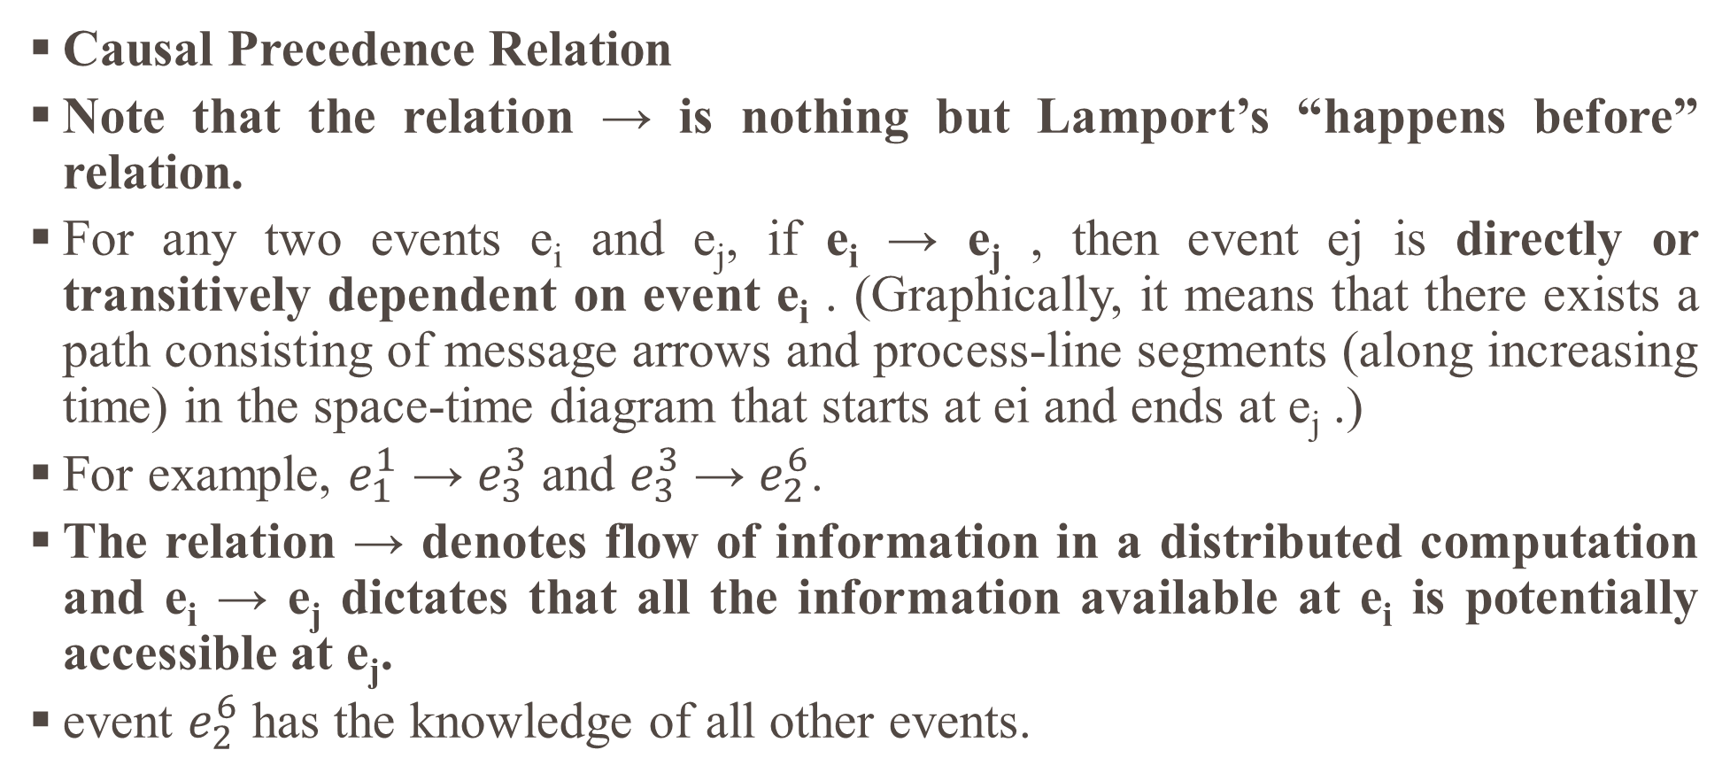
A model of distributed computations:
Causal Precedence Relation
Note that the relation → is nothing but Lamport’s “happens before” relation.
For any two events e_{i} and e_{j}, if e_{i} → e_{j} , then event ej is directly or transitively dependent on event e_{i} . (Graphically, it means that there exists a path consisting of message arrows and process-line segments (along increasing time) in the space-time diagram that starts at ei and ends at e_{j} .)
For example, $e_{1}^{1}$ → $e_{3}^{3}$ and $e_{3}^{3}$ → $e_{2}^{6}$.
The relation → denotes flow of information in a distributed computation and e_{i} → e_{j} dictates that all the information available at e_{i} is potentially accessible at e_{j}.
event $e_{2}^{6}$ has the knowledge of all other events.

Slide 65
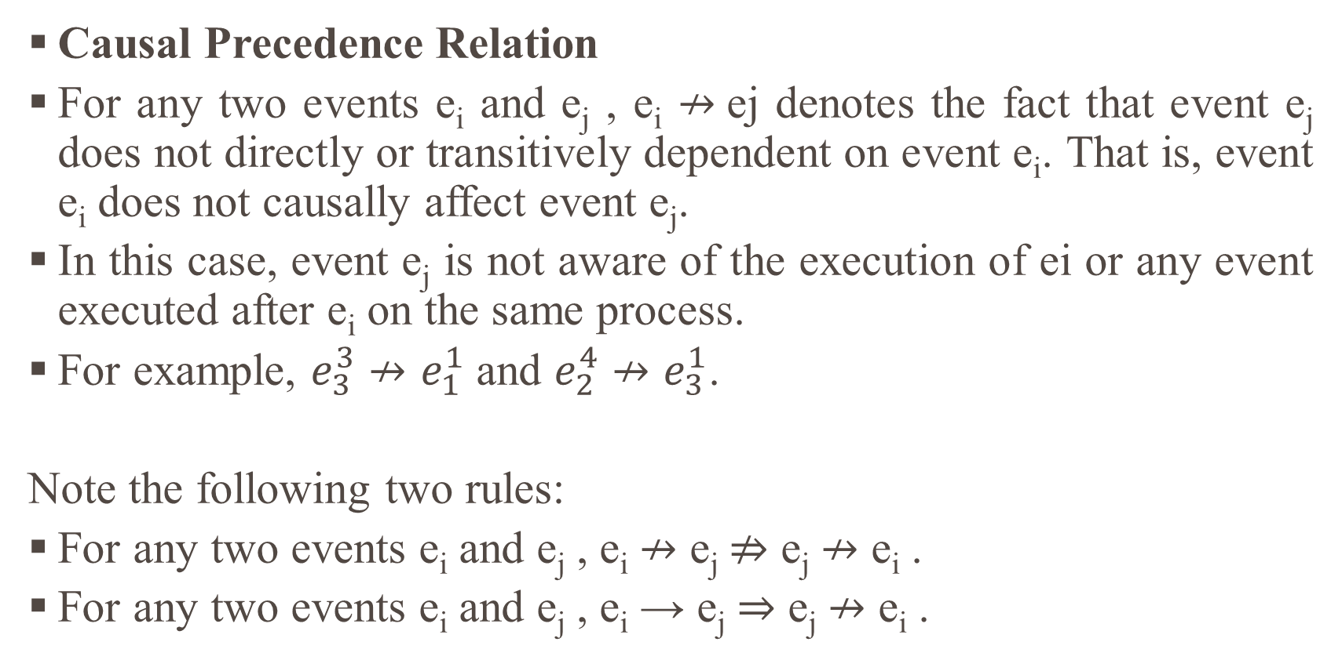
A model of distributed computations:
Causal Precedence Relation
For any two events e_{i} and e_{j} , e_{i} $↛$ej denotes the fact that event e_{j} does not directly or transitively dependent on event e_{i}. That is, event e_{i} does not causally affect event e_{j}.
In this case, event e_{j} is not aware of the execution of ei or any event executed after e_{i} on the same process.
For example, $e_{3}^{3}$ $↛e_{1}^{1}$ and $e_{2}^{4}$ $↛e_{3}^{1}$.
Note the following two rules:
For any two events e_{i} and e_{j} , e_{i} $↛$ e_{j} $⇏$ e_{j} $↛$ e_{i} .
For any two events e_{i} and e_{j} , e_{i} → e_{j} ⇒ e_{j} $↛$ e_{i} .

Slide 66
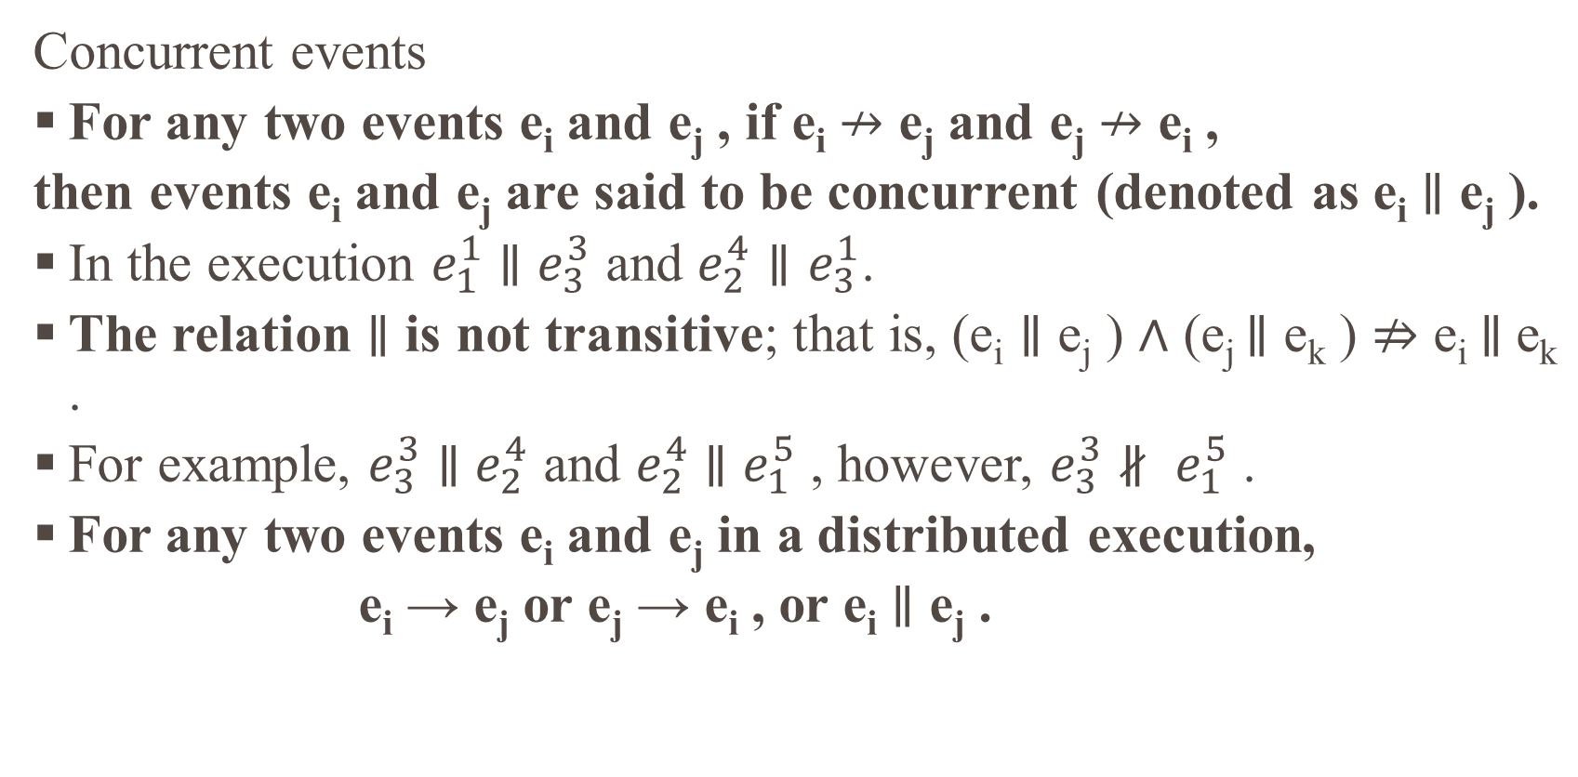
A model of distributed computations:
Concurrent events
For any two events e_{i} and e_{j} , if e_{i} $↛$ e_{j} and e_{j} $↛$ e_{i} ,
then events e_{i} and e_{j} are said to be concurrent (denoted as e_{i} $∥$ e_{j} ).
In the execution $e_{1}^{1}$ $∥$ $e_{3}^{3}$ and $e_{2}^{4}∥e_{3}^{1}$.
The relation $∥$ is not transitive; that is, (e_{i} $∥$ e_{j} ) ∧ (e_{j} $∥$ e_{k} ) $⇏$ e_{i} $∥$e_{k} .
For example, $e_{3}^{3}$ $∥$ $e_{2}^{4}$ and $e_{2}^{4}$ $∥$ $e_{1}^{5}$ , however, $e_{3}^{3}$ $∦ e_{1}^{5}$ .
For any two events e_{i} and e_{j} in a distributed execution,
e_{i} → e_{j} or e_{j} → e_{i} , or e_{i} $∥$ e_{j} .

Slide 67
A model of distributed computations:
(3) Models of communication networks
There are several models of the service provided by communication networks, namely, FIFO (first-in, first-out), non-FIFO, and causal ordering.
In the FIFO model, each channel acts as a first-in first-out message queue and thus, message ordering is preserved by a channel.
In the non-FIFO model, a channel acts like a set in which the sender process adds messages and the receiver process removes messages from it in a random order.

Slide 68
A model of distributed computations:
(4) Global state of a distributed system
The global state of a distributed system is a collection of the local states of its components, namely, the processes and the communication channels.
The state of a process at any time is defined by the contents of processor registers, stacks, local memory, etc. and depends on the local context of the distributed application.
The state of a channel is given by the set of messages in transit in the channel.

Slide 69
REFERENCE
TEXT BOOKS:
Ajay D. Kshemkalyani, Mukesh Singhal, ― Distributed Computing: Principles, Algorithms, and Systems, Cambridge University Press, 2011. (Unit 1, 2, 3).
Douglass E. Comer, ― The Cloud Computing Book: The future of computing explained, CRC Press, 2021. (Unit 4, 5).
REFERENCES:
Arshdeep Bahga, Vijay Madisetti, ― Cloud Computing: A Hands-on Approach‖, Universities Press Private Limited, 2014.
Rajkumar Buyya, Christian Vecchiola, S. ThamaraiSelvi, ―Mastering Cloud Computing, Tata Mcgraw Hill, 2017.
Kai Hwang, Geoffrey C. Fox, Jack G. Dongarra, ―Distributed and Cloud Computing, From Parallel Processing to the Internet of Things, Morgan Kaufmann Publishers, 2012.
Hagit Attiya, Jennifer Welch, ―Distributed Computing: Fundamentals, Simulations and Advanced Topics, John Wiley & Sons, Inc., 2004.

Slide 70

Thank You…

